Slide 1
Web Crawling

Slide 2
Summer Job Survey
If you are a CSC major, please be sure to complete the survey, available from the department website.
Our ABET accreditation visitors will be interested.

Slide 3
Picking up where we left off last week
So far
Reviewed the syllabus, general class organization and expectations
Talked a bit about the beginnings of the web
You have now read Vannevar Bush’s As We May Think
Response? Where was he right? Where was he wrong? What did he not envision? Did you notice anything about the writing style?
Web Characteristics
Lack of structure, organization to the collection
Basic client-server model; http
Introduction to search
Crawling – one essential step in applications that may involve searching, information organization
requirements (Robust, Polite)
Expectations (Distributed, Scalable, Efficient, Useful, Fresh, Extensible

Slide 4
Basic Crawl Architecture
WWW
DNS
Doc
FP’s
robots
filters
URL
set
Parse
Fetch
Content
seen?
URL
filter
Dup
URL
elim
URL Frontier
Ref: Manning Introduction to Information Retrieval

Slide 5
Crawler Architecture
Modules:
The URL frontier (the queue of URLs still to be fetched, or fetched again)
A DNS resolution module (The translation from a URL to a web server to talk to)
A fetch module (use http to retrieve the page)
A parsing module to extract text and links from the page
A duplicate elimination module to recognize links already seen
Ref: Manning Introduction to Information Retrieval

Slide 6
Crawling threads
With so much space to explore, so many pages to process, a crawler will often consist of many threads, each of which cycles through the same set of steps we just saw. There may be multiple threads on one processor or threads may be distributed over many nodes in a distributed system.

Slide 7
Politeness
Not optional.
Explicit
Specified by the web site owner
What portions of the site may be crawled and what portions may not be crawled
robots.txt file
Implicit
If no restrictions are specified, still restrict how often you hit a single site.
You may have many URLs from the same site. Too much traffic can interfere with the site’s operation. Crawler hits are much faster than ordinary traffic – could overtax the server. (Constitutes a denial of service attack) Good web crawlers do not fetch multiple pages from the same server at one time.

Slide 8
Robots.txt
Protocol nearly as old as the web
See www.rototstxt.org/robotstxt.html
File: URL/robots.txt
Contains the access restrictions
Example:
User-agent: *
Disallow: /yoursite/temp/
User-agent: searchengine
Disallow:
All robots (spiders/crawlers)
Robot named searchengine only
Nothing disallowed
Source: www.robotstxt.org/wc/norobots.html

Slide 9
Another example
User-agent: *
Disallow: /cgi-bin/
Disallow: /tmp/
Disallow: /~joe/

Slide 10
Processing robots.txt
First line:
User-agent – identifies to whom the instruction applies. * = everyone; otherwise, specific crawler name
Disallow: or Allow: provides path to exclude or include in robot access.
Once the robots.txt file is fetched from a site, it does not have to be fetched every time you return to the site.
Just takes time, and uses up hits on the server
Cache the robots.txt file for repeated reference

Slide 11
Robots <META> tag
robots.txt provides information about access to a directory.
A given file may have an html meta tag that directs robot behavior
A responsible crawler will check for that tag and obey its direction.
Ex:
<META NAME=“ROBOTS” CONTENT = “INDEX, NOFOLLOW”>
OPTIONS: INDEX, NOINDEX, FOLLOW, NOFOLLOW
See http://www.w3.org/TR/html401/appendix/notes.html#h-B.4.1.2 and http://www.robotstxt.org/meta.html

Slide 12
Crawling
Pick a URL from the frontier
Fetch the document at the URL
Parse the URL
Extract links from it to other docs (URLs)
Check if URL has content already seen
If not, add to indices
For each extracted URL
Ensure it passes certain URL filter tests
Check if it is already in the frontier (duplicate URL elimination)
Which one?
E.g., only crawl .edu, obey robots.txt, etc.
Ref: Manning Introduction to Information Retrieval

Slide 13
Basic Crawl Architecture
WWW
DNS
Doc
FP’s
robots
filters
URL
set
Parse
Fetch
Content
seen?
URL
filter
Dup
URL
elim
URL Frontier
Ref: Manning Introduction to Information Retrieval

Slide 14
DNS – Domain Name Server
Internet service to resolve URLs into IP addresses
Distributed servers, some significant latency possible
OS implementations – DNS lookup is blocking – only one outstanding request at a time.
Solutions
DNS caching
Batch DNS resolver – collects requests and sends them out together
Ref: Manning Introduction to Information Retrieval

Slide 15
Parsing
Fetched page contains
Embedded links to more pages
Actual content for use in the application
Extract the links
Relative link? Expand (normalize)
Seen before? Discard
New?
Meet criteria? Append to URL frontier
Does not meet criteria? Discard
Examine content

Slide 16
Content
Seen before?
How to tell?
Finger Print, Shingles
Documents identical, or similar
If already in the index, do not process it again
Ref: Manning Introduction to Information Retrieval

Slide 17
Distributed crawler
For big crawls,
Many processes, each doing part of the job
Possibly on different nodes
Geographically distributed
How to distribute
Give each node a set of hosts to crawl
Use a hashing function to partition the set of hosts
How do these nodes communicate?
Need to have a common index
Ref: Manning Introduction to Information Retrieval

Slide 18
Communication between nodes
The output of the URL filter at each node is sent to the Duplicate URL Eliminator at all nodes
WWW
To
other
hosts
DNS
Doc
FP’s
robots
filters
URL
set
Parse
Fetch
Content
seen?
URL
filter
Host
splitter
Dup
URL
elim
From
other
hosts
URL Frontier
Ref: Manning Introduction to Information Retrieval

Slide 19
URL Frontier
Two requirements
Politeness: do not go too often to the same site
Freshness: keep pages up to date
News sites, for example, change frequently
Conflicts – The two requirements may be directly in conflict with each other.
Complication
Fetching URLs embedded in a page will yield many URLs located on the same server. Delay fetching those.
Ref: Manning Introduction to Information Retrieval

Slide 20
More …
We will examine these things more completely. What will you actually do?
Goal
Write a simple crawler
Not distributed, not multi-threaded
Use a seed URL, connect with the server, fetch the document, extract links, extract content
Explore existing crawlers
Evaluate their characteristics
Learn to use one to do serious crawling
Process the documents fetched to serve some purpose. Create a web site for that purpose.
Ref: Manning Introduction to Information Retrieval

Slide 21
Processing the documents
Create an index and store the documents and the index so that appropriate content can be found when needed.
Learn the fundamentals of information retrieval as they apply to web services

Slide 22
A language suggestion
Using the right language is often the key to making a task reasonable, easy, or very difficult
There are languages designed and optimized for text manipulation. Perl and Python are examples.
We will spend a bit of time learning the fundamentals of python. You may use whatever language you wish for your programming.

Slide 23
Introducing Python
"Python is an open-source object-oriented programming language that offers two to ten fold programmer productivity increases over languages like C, C++, Java, C#, Visual Basic (VB), and Perl.”
(http://pythoncard.sourceforge.net/what_is_python.html)
See also: “Why Python” by Eric Raymond at
http://www.linuxjournal.com/article/3882
Interpreted language
Widely used (including by Google)
See http://google-styleguide.googlecode.com/svn/trunk/pyguide.html
for the Google Python Style Guide if interested

Slide 24
Starting Python
See
http://docs.python.org/tutorial/introduction.html
Python is probably on your computer. If not, please download it and install. Everything you need is at http://python.org
Python includes libraries and tools that will be very useful for writing a web crawler.

Slide 25
Python - 1
$ python
Python 2.6.1 (r261:67515, Jun 24 2010, 21:47:49)
[GCC 4.2.1 (Apple Inc. build 5646)] on darwin
Type "help", "copyright", "credits" or "license" for more information.
>>> print "Hello world!"
Hello world!
>>>

Slide 26
Useful Python elements
Sequences
Lists, Tuples, Strings
Numbers and numeric operations
Control structures
Useful modules for Web Application development

Slide 27
Class: list
Ordered collection of elements, mutable
list() creates an empty list
movies = list() makes an empty list with the name (identifier) movies
What can we do to a list? Some examples:
append(x) – add an item, x, to the end of the list
extend(L) – Extend the list by appending all the items of list L
insert(i,x) – insert item x at position i of the list
remove(x) – remove the first item in the list with value = x (error if none exist)
pop(i) – return item at location i (and remove it from the list) If no index (i) is provided, remove and return the last item of the list.
index(x) – return the index value for the first occurrence of x
count(x) – return the number of occurrences of x in the list
sort() – sort the list, in place
reverse() – reverse the order of the elements in the list

Slide 28
New lists
from old lists
places[0:3]
places[1:4:2]
places + otherplaces
note places + “pub” vs places +[‘pub’]
places * 2
Creating a list
range(5,100,25) -- how many entries

Slide 29
Immutable objects
Lists are mutable.
Operations that can change a list –
Name some –
Two important types of objects are not mutable: str and tuple
tuple is like a list, but is not mutable
A fixed sequence of arbitrary objects
Defined with () instead of []
grades = (“A”, “A-”, “B+”,”B”,”B-”,”C+”,”C”)
str (string) is a fixed sequence of characters
Operations on lists that do not change the list can be applied to tuple and to str also
Operations that make changes must create a new copy of the structure to hold the changed version

Slide 30
Strings
Strings are specified using quotes – single or double
name1 = “Ella Lane”
name2= ‘Tom Riley’
If the string contains a quotation mark, it must be distinct from the marks denoting the string:
part1= “Ella’s toy”
Part2=‘Tom\’s plane’

Slide 31
Methods
In general, methods that do not change the list are available to use with str and tuple
String methods
>>> message=(“Meet me at the coffee shop. OK?”)
>>> message.lower()
'meet me at the coffee shop. ok?'
>>> message.upper()
'MEET ME AT THE COFFEE SHOP. OK?'

Slide 32
Immutable, but…
It is possible to create a new string with the same name as a previous string. This leaves the previous string without a label.
>>> note="walk today"
>>> note
'walk today'
>>> note = "go shopping"
>>> note
'go shopping'
The original string is still there, but cannot be accessed because it no longer has a label

Slide 33
Strings and Lists of Strings
Note that there are no spaces in the words in the list. The spaces were used to separate the words and are dropped.
Extract individual words from a string
>>> words = message.split()
>>> words
['Meet', 'me', 'at', 'the', 'coffee', 'shop.', 'OK?']
OK to split on any token
>>> terms=("12098,scheduling,of,real,time,10,21,,real time,")
>>> terms
'12098,scheduling,of,real,time,10,21,,real time,'
>>> termslist=terms.split()
>>> termslist
['12098,scheduling,of,real,time,10,21,,real', 'time,']
>>> termslist=terms.split(',')
>>> termslist
['12098', 'scheduling', 'of', 'real', 'time', '10', '21', '', 'real time', '’]

Slide 34
Join words of a string to words in a list to form a new string
words=['Meet','me','at','the','coffee','shop.','OK?']
wordstring = ""
for word in words:
wordstring += word
print 'Words concatenated:' ,wordstring
print 'After using join: ',
wordstring = ' '.join(words)
print wordstring
Output:
Words concatenated: Meetmeatthecoffeeshop.OK?
After using join: Meet me at the coffee shop. OK?

Slide 35
String Methods
Methods for strings, not lists:
terms.isalpha()
terms.isdigit()
terms.isspace()
terms.islower()
terms.isupper()
message.lower()
message.upper()
message.capitalize()
message.center(80) (center in 80 places)
message.ljustify(80) (left justify in 80 places)
message.rjustify(80)
message.strip() (remove left and right white spaces)
message.strip(chars) (returns string with left and/or right chars removed)
startnote.replace("Please m","M")

Slide 36
Spot check
With a partner, do
Create a list of at least five items
Sort the list
Print out the list in reverse order
How few lines do you need?

Slide 37
Numeric types
int – whole numbers, no decimal places
float – decimal numbers, with decimal place
long – arbitrarily long ints. Python does conversion when needed
operations between same types gives result of that type
operations between int and float yields float
>>> 3/2
1
>>> 3./2.
1.5
>>> 3/2.
1.5
>>> 3.//2.
1.0
>>> 18%4
2
>>> 18//4
4

Slide 38
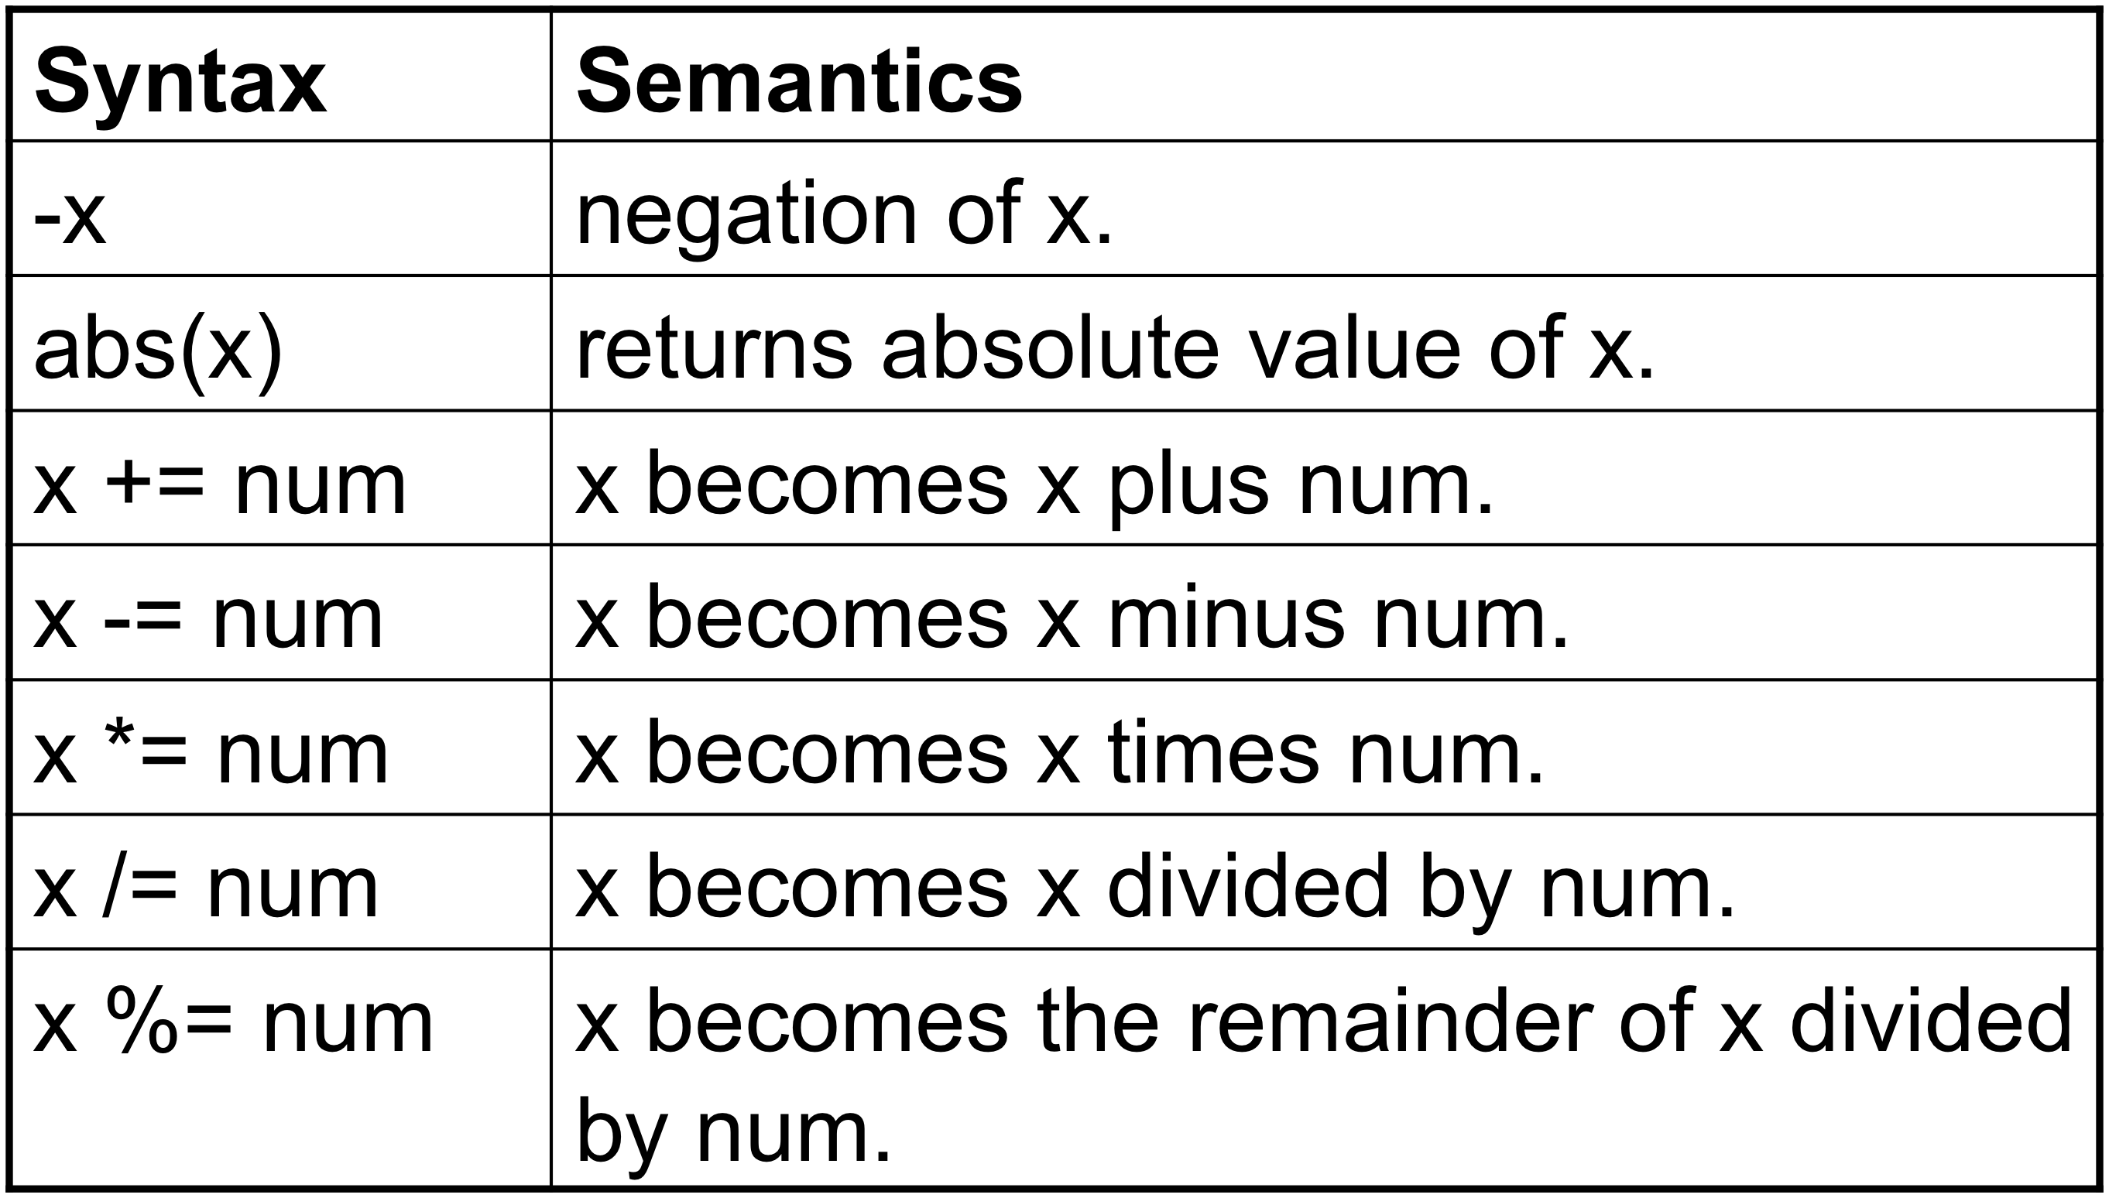
Numeric operators
book slide

Slide 39
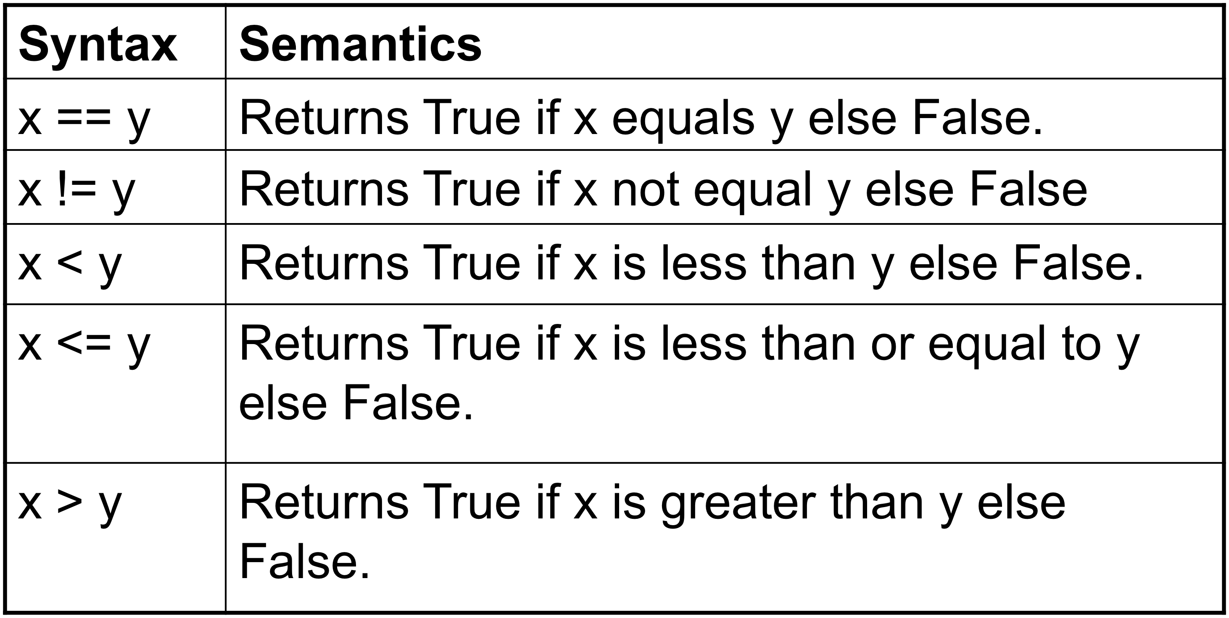
Numeric Operators
book slide

Slide 40
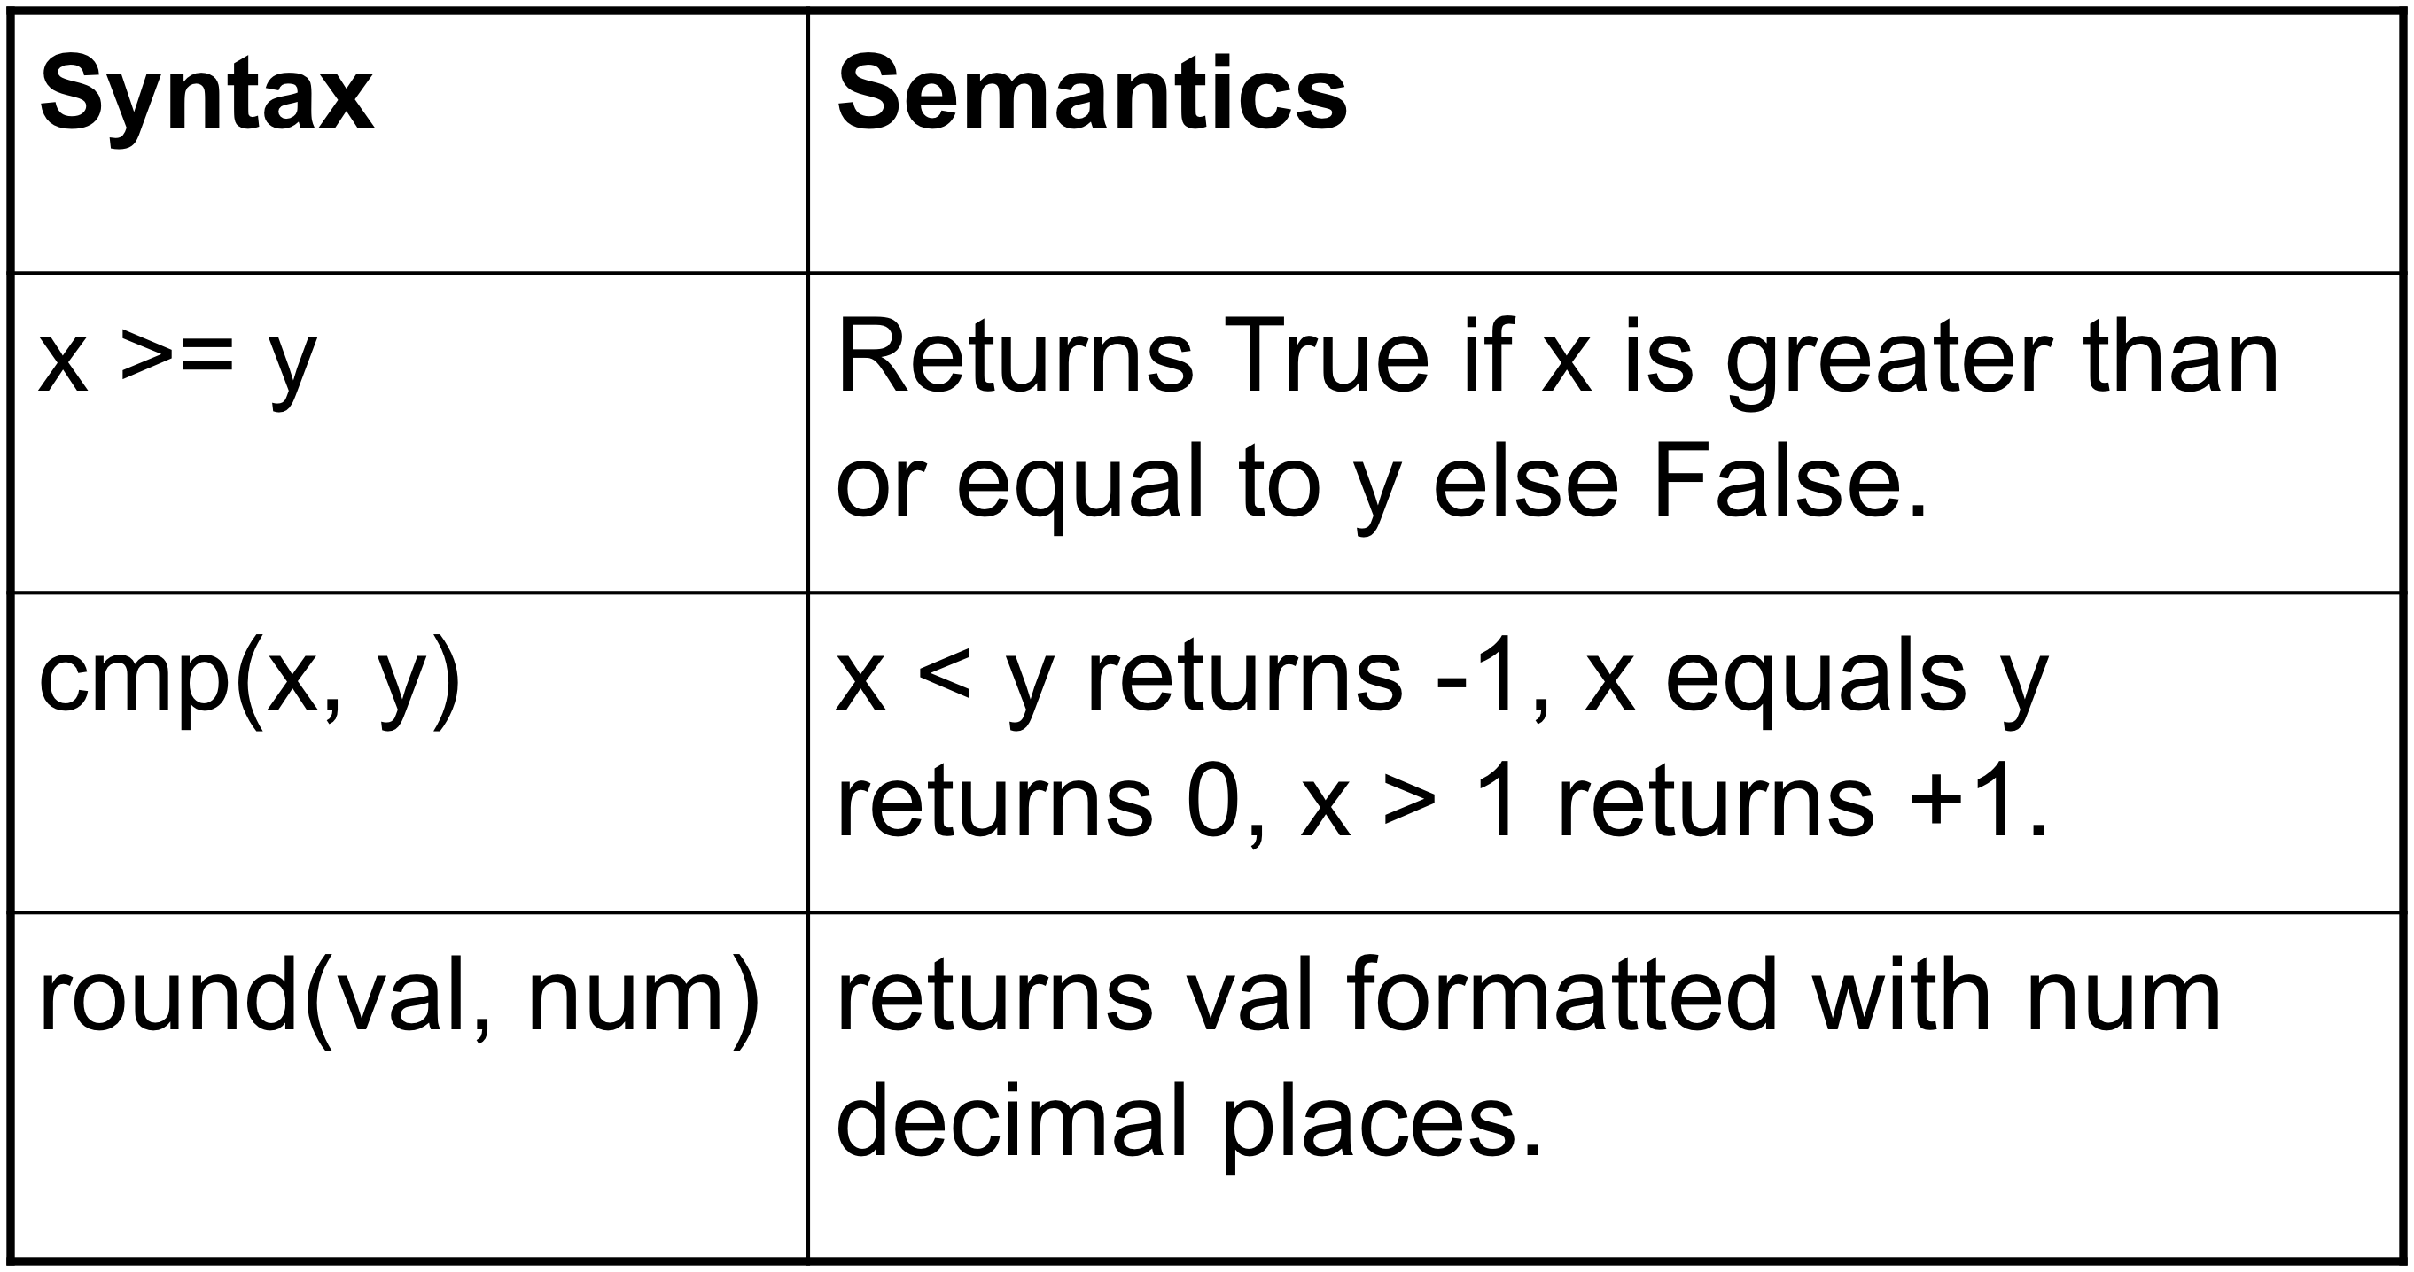
Numeric Operators
book slide

Slide 41
Casting
Convert from one type to another
>>> str(3.14159)
'3.14159'
>>> int(3.14159)
3
>>> round(3.14159)
3.0
>>> round(3.5)
4.0
>>> round(3.499999999999)
3.0
>>> num=3.789
>>> num
3.7890000000000001
>>> str(num)
'3.789'
>>> str(num+4)
'7.789’
>>> str(num)
'3.789'
>>> str(num+4)
'7.789'
>>>
>>> list(num)
Traceback (most recent call last):
File "<stdin>", line 1, in <module>
TypeError: 'float' object is not iterable
>>> list(str(num))
['3', '.', '7', '8', '9']
>>> tuple(str(num))
('3', '.', '7', '8', '9')

Slide 42
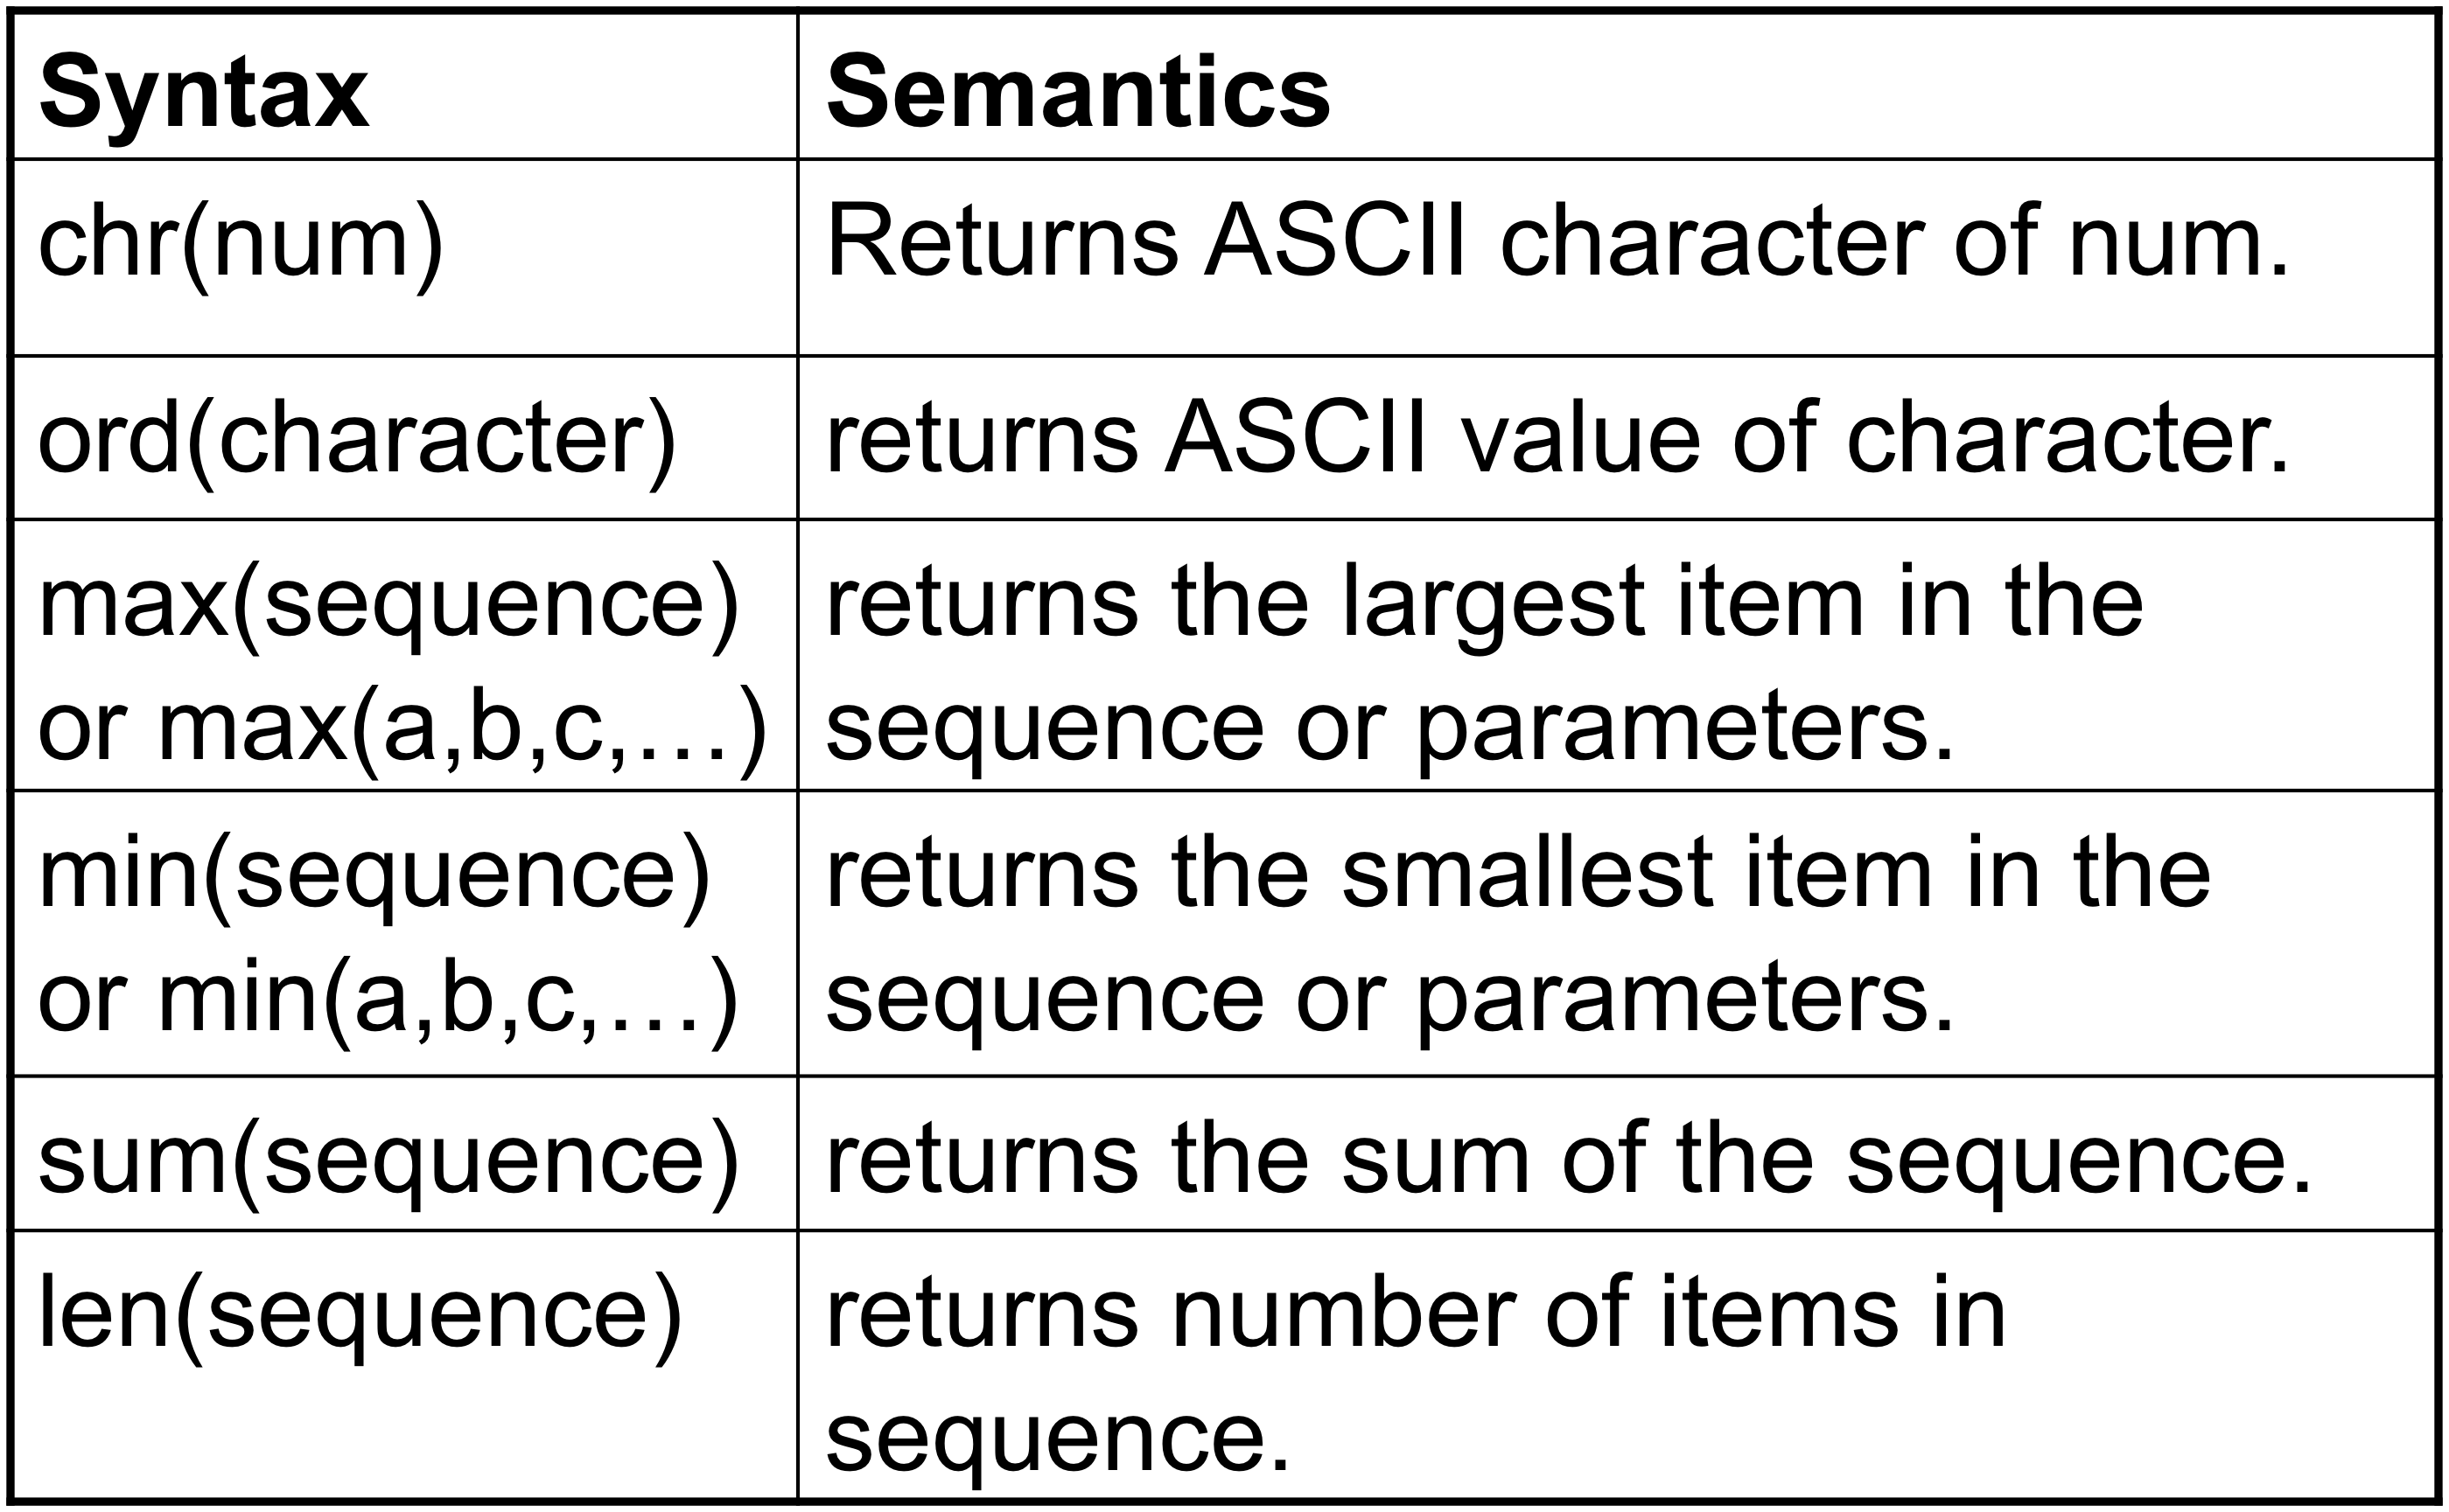
Functions
We have seen some of these before
book slide

Slide 43
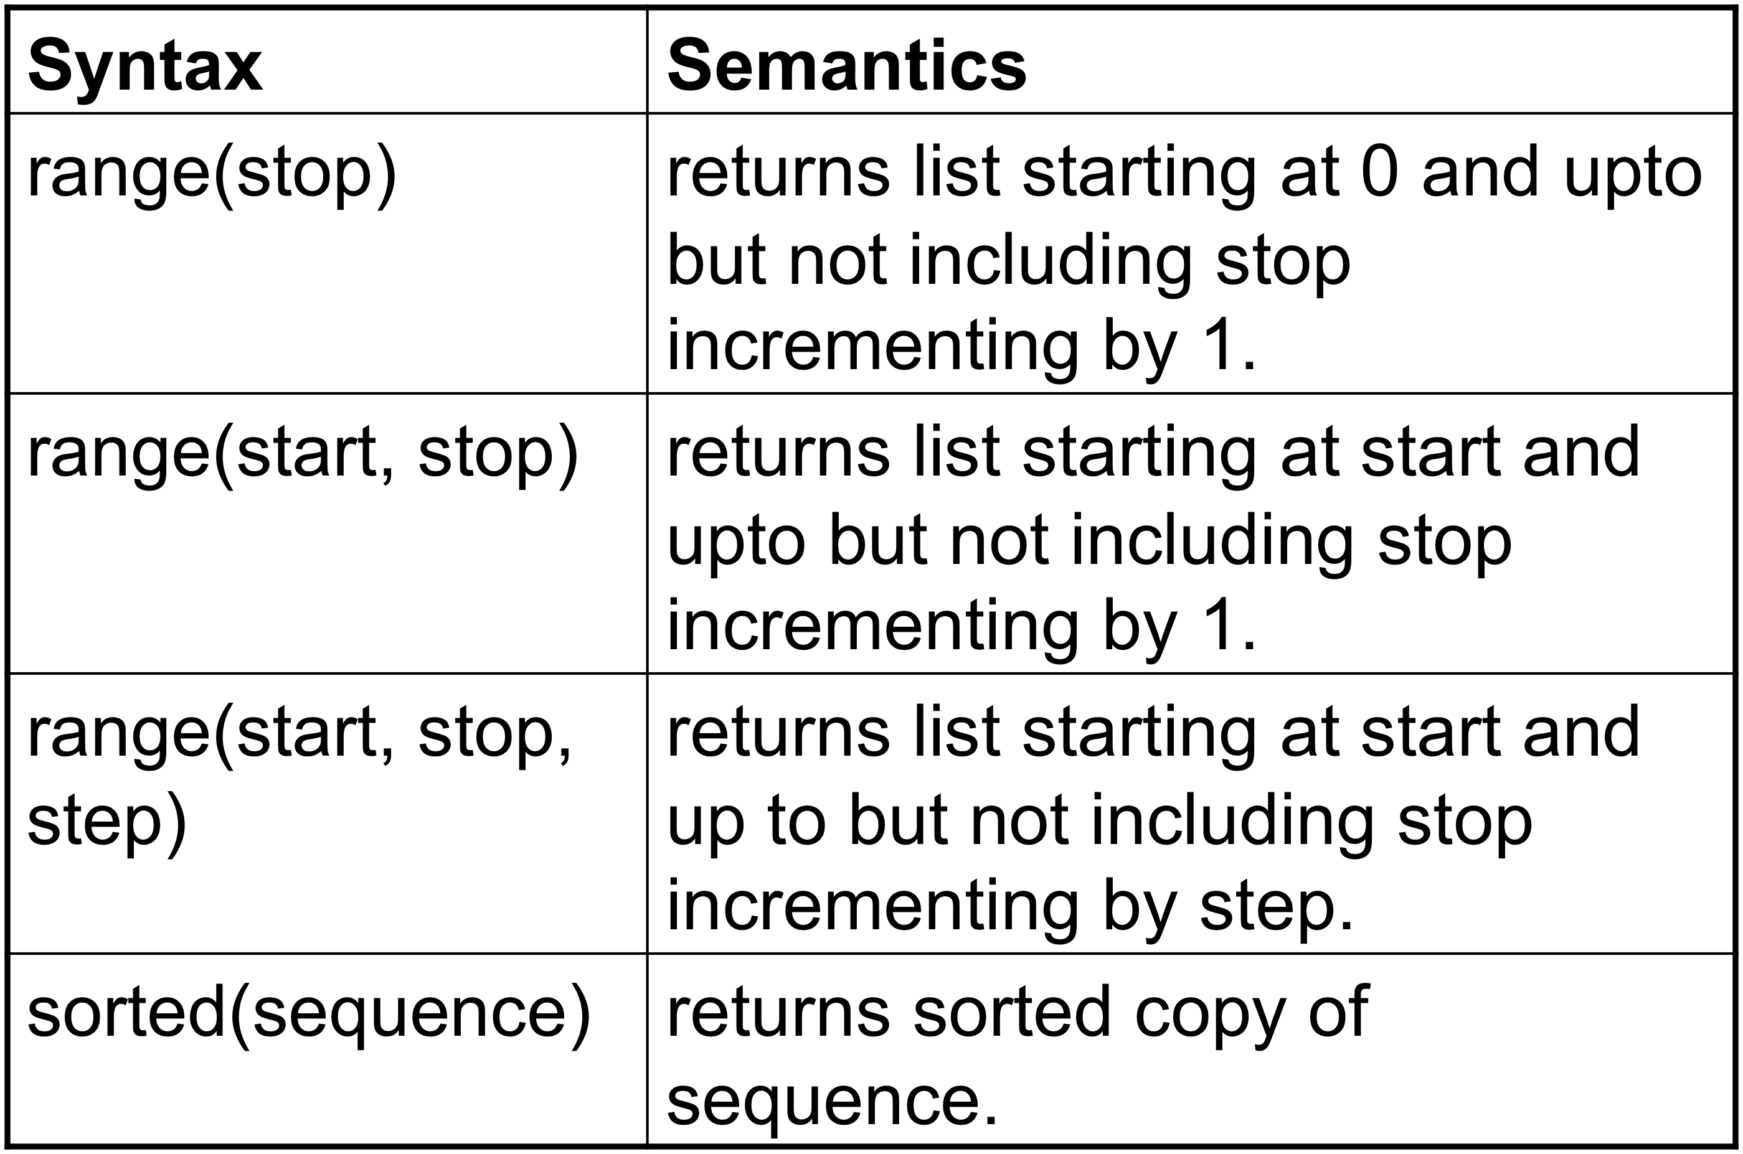
Functions
book slide

Slide 44
Modules
Collections of things that are very handy to have, but not as universally needed as the built-in functions.
>>> from math import pi
>>> pi
3.1415926535897931
>>> import math
>>> math.sqrt(32)*10
56.568542494923804
>>>
We will use modules specific to web application development
Once imported, use help(<module>) for full documentation

Slide 45
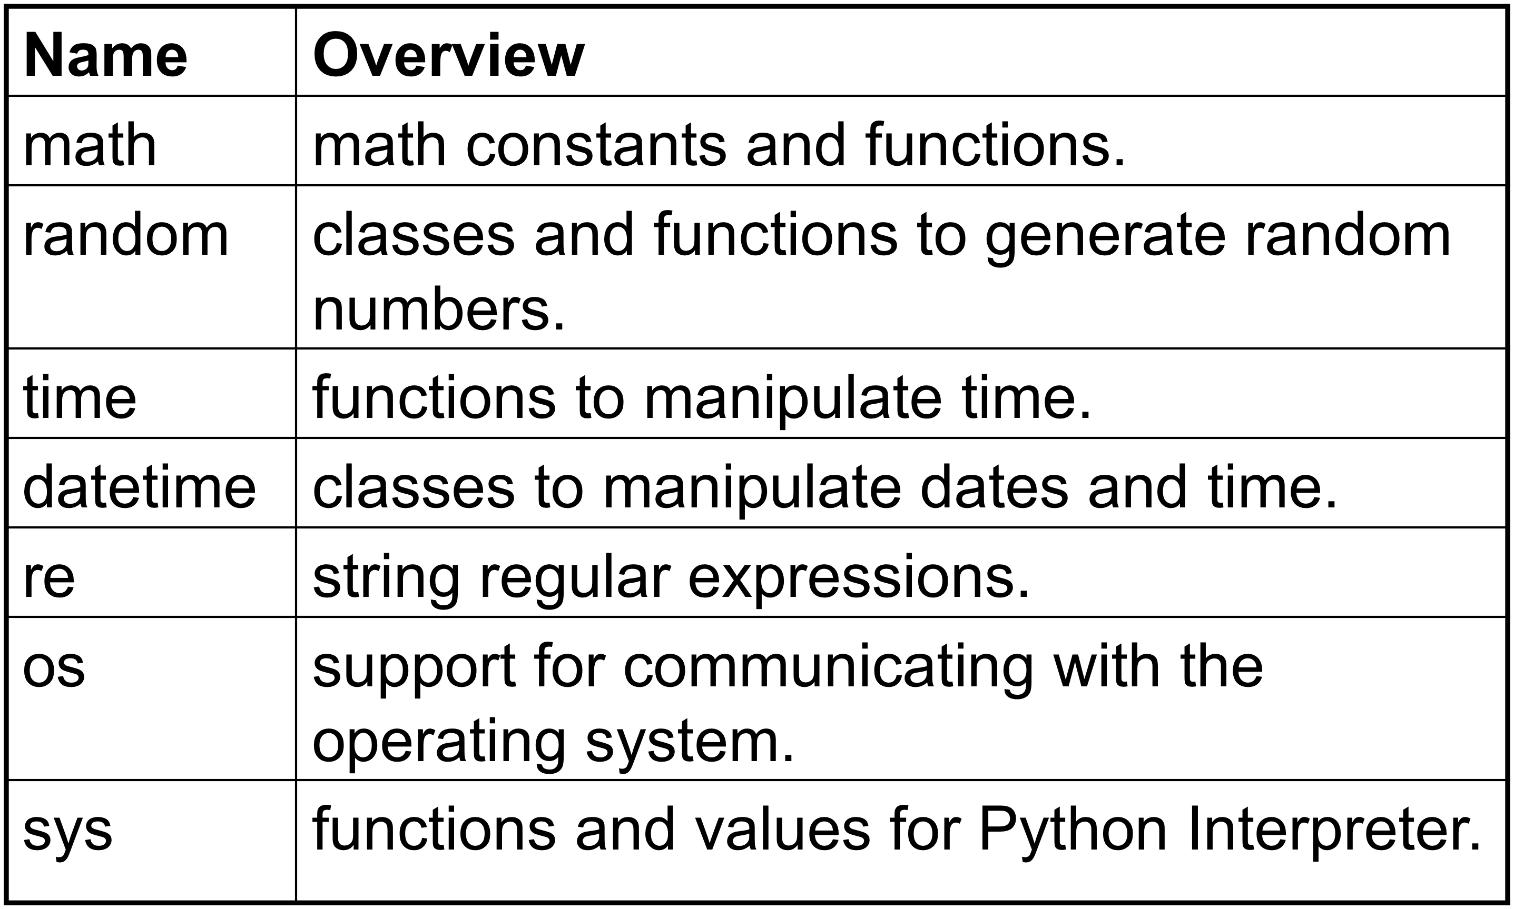
Common modules
book slide

Slide 46
Expressions
Several part operations, including operators and/or function calls
Order of operations same as arithmetic
Function evaluation
Parentheses
Exponentiation (right to left)
Multiplication and Division (left to right)
Addition and Subtraction (left to right)
book slide

Slide 47
Boolean Values are False or True
X | Y | not X | X and Y | X or Y | X == Y | X != y
False | False | True | False | False | True | False
False | True | True | False | True | False | True
True | False | False | False | True | False | True
True | True | False | True | True | True | False
book slide

Slide 48
Source code in file
Avoid retyping each command each time you run the program. Essential for non-trivial programs.
Allows exactly the same program to be run repeatedly -- still interpreted, but no accidental changes
Use print statement to output to display
File has .py extension
Run by typing python <filename>.py
python termread.py

Slide 49
Basic I/O
print
list of items separated by commas
automatic newline at end
forced newline: the character ‘\n’
raw_input(<string prompt>)
input from the keyboard
input comes as a string. Cast it to make it into some other type
input(<prompt>)
input comes as a numeric value, int or float

Slide 50
Case Study – Date conversion
months = ('Jan', 'Feb', 'Mar', 'Apr', 'May', 'Jun', 'Jul', 'Aug', 'Sep', 'Oct', 'Nov', 'Dec')
date = raw_input('Enter date (mm-dd-yyyy) ')
pieces = date.split('-')
monthVal = months[int(pieces[0])-1]
print monthVal + ' ' + pieces[1] +', ' +pieces[2]
Try it – run it on your machine with a few dates

Slide 51
Spot check
Again, split the class. Work in pairs
First do this:
Prompt for a name, first name first
Print out the name as
lastname, firstname
Then do this:
Find the number of occurrences of the string named pattern in a string named statement
(prompt for the string and the pattern, then do the count and output the result)

Slide 52
Control structures
Conditionals, repetition
IF:
if <condition>:
<instruction(s) to execute>
if <condition>:
<instruction(s) to execute if true>
else:
<instruction(s) to execute if false>

Slide 53
Nested if
Consider this example code:
values = range(27,150,4)
print values
x=raw_input("Enter x:")
if x in values:
print "x in value set", x
else:
if x> 50:
print "new x greater than 50"
else:
print "new x less than 50"
Note that the required indentation makes python code very readable

Slide 54
Shortened nested if
values = range(27,150,4)
print values
strx=raw_input("Enter x:")
x=int(strx)
if x in values:
print "x in value set", x
elif x> 50:
print "new x greater than 50"
else:
print "new x less than 50"

Slide 55
Spot check
Repeat the date example, but add a check for valid entries

Slide 56
for
iterative loop
A loop variable takes on each value in a specified sequence, executes the body of the code with the current value, repeats for each value.
for <variable> in <sequence>:
<block of code to execute>
Sequence may be a list, a range, a tuple, a string

Slide 57
Iterating through a string
teststring = "When in the course of human events, it becomes necessary ..."
countc = 0
for c in teststring:
if c == "a":
countc +=1
print "Number of c's in the string: ", countc

Slide 58
Stepping through a list
cousins=["Mike", "Carol", "Frank", "Ann", "Jim", "Pat", "Franny",\
"Elizabeth", "Richard", "Sue"]
steps = range(len(cousins))
for step in steps:
print cousins[step]+", ",
Output:
Mike, Carol, Frank, Ann, Jim, Pat, Franny, Elizabeth, Richard, Sue,
Exercise:
Get rid of that last comma.

Slide 59
Stepping through the list again
cousins=["Mike", "Carol", "Frank", "Ann", "Jim", "Pat", "Franny",\
"Elizabeth", "Richard", "Sue"]
for step in range(len(cousins)):
print cousins[step]+", ”,
Output
Mike, Carol, Frank, Ann, Jim, Pat, Franny, Elizabeth, Richard, Sue,

Slide 60
While loop
while <condition>:
body
Note that there is a required : after the first line, but no punctuation after lines in the body. The indentation shows what belongs to the body.

Slide 61
Files
Built-in file class
Two ways to input a line from the file:
line=source.readline()
for line in source:
where line and source are local names
Note – no explicit read in the for loop
filename=raw_input('File to read: ')
source = file(filename) #Access is read-only
for line in source:
print line

Slide 62
Another iteration over file
a = open("numgone.txt", "r")
line = a.readline()
while line:
print line[0]
line = a.readline() # Note that the content of line changes
# here, resetting the loop
a.close()

Slide 63
File I/O
File object can be created with open() built-in function
File methods: (Selected)
file.close()
file.flush()
file.read([size]) -- read at most size bytes from the file. If size omitted, read to end of file
file.readline([size]) – read one line of the file. Optional size determines maximum number of bytes returned and may produce an incomplete line.
file.readlines() – read to EOF, returning a list of the file lines
file.write(str) – write str to file. May need flush or close to complete the file write
writelines(sequence) – writes a sequence, usually a list of strings

Slide 64
Basics of HTML
Web pages are coded with HTML
Each browser has a way of displaying the page coding, but it differs.
Essentials – tags
<something> ….. </something>
Essentials – links
<a href=“url of the resource”> text to highlight </a>
Tags, including link tags, may have other parameters. All will start with < and end with >
Sometimes, the closing tag may be missing
<p> not always followed by a </p>

Slide 65
Next week
Python code for retrieving web pages (crawling)
Demonstration of crawling visualization

